Slide 1


Watermark sse Student Success & engagement early alert training
DIVISION OF ENROLLMENT MANAGEMENT AND STUDENT SUCCESS
Student Success Center
Spring 2026

Slide 2
objectives
Participants will be able to:
Describe the purpose of WATERMARK SSE
Log-on and Navigate the software
Send Early Alerts

Slide 3
Purpose of watermark SSE
Early Alert
Communicate, Connect and Engage Students
Predictive Analytics

Slide 4
Quick start tasks

Slide 5
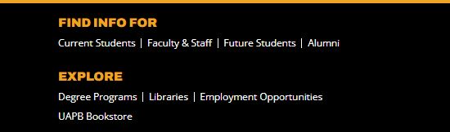


1. Log-in and navigate software
https://uapb.avisoapp.com
OR
2. Go to UAPB website main page
Select Scroll down to “Find Info for”
Select Faculty& Staff
Select AVISO Engage

Slide 6
1. Send single early alert
Single Alert
Search for student by Student ID (e.g. 300330169) or Proper Name (John Doe)
Select Alert above student name
Select Alert reason
Enter Message in comment
Send message

Slide 7
2. Send course alerts
Course Alert
Select Course
Select box beside a single student or multiple students to receive alert
Select Alert above course name
Select Alert reason
Enter Message in comment
Send message

Slide 8
3. Send group early alerts
Note: Group of students not in your course
Step 1: Create Filter for the group with identical alert
Select students from the menu
Select Plus Sign (+) for permanent filter or the funnel icon for a temporary filter
Name filter
Select Everyone
Scroll down to Student List - Copy and past ID numbers into box
Select include registration terms if desired
Select tags if desired
Select any and all other desired filters if desired
Select Save at the top

Slide 9
3. Send group early alerts
Step 2: Send identical alert to group
Select Filter previously created
Select Alert above Filter
Select Reason from pull down menu
Enter Message in comment
Save and Send

Slide 10
Questions?
Rita Conley, Student Success Center Director
conleyr@uapb.edu
870-575-8368

